Slide 1
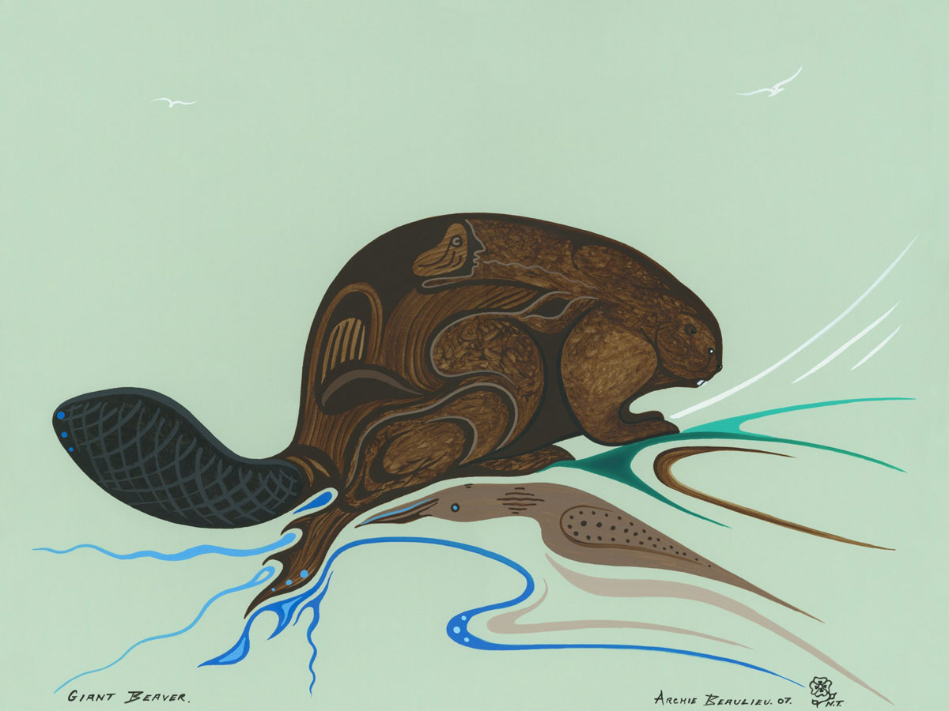
Giant Beaver
The Giant Beaver
FNMI Perspectives
Science 10 Unit D (Climate)
Science 20 Unit D (Geology)

Slide 2
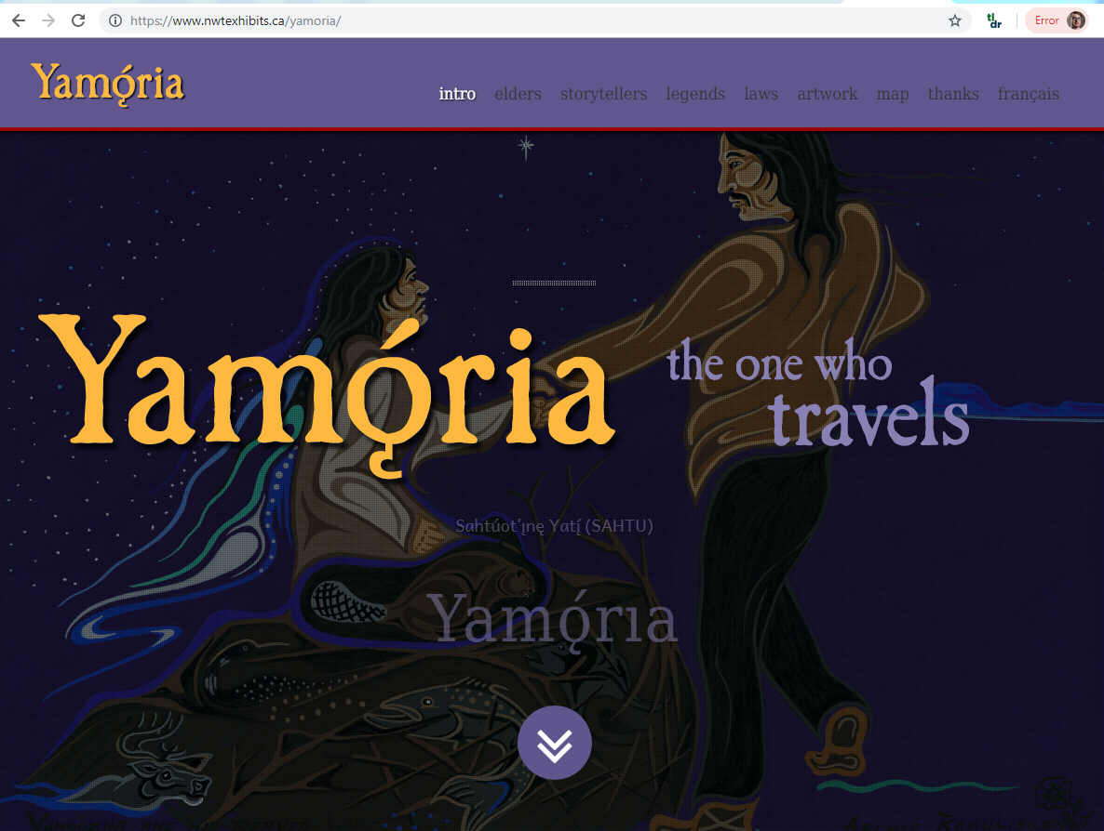
www.nwtexhibits.ca/yamoria/
Notes:
On a trip through the Yukon about 5 years ago, I stopped at the Beringia interpretative center and discovered some of the stories of the northern Dene people.
Dene: Ya – MO – ya

Slide 3
www.nwtexhibits.ca/yamoria/
Notes:
Dene: Ya – MO – ya

Slide 4
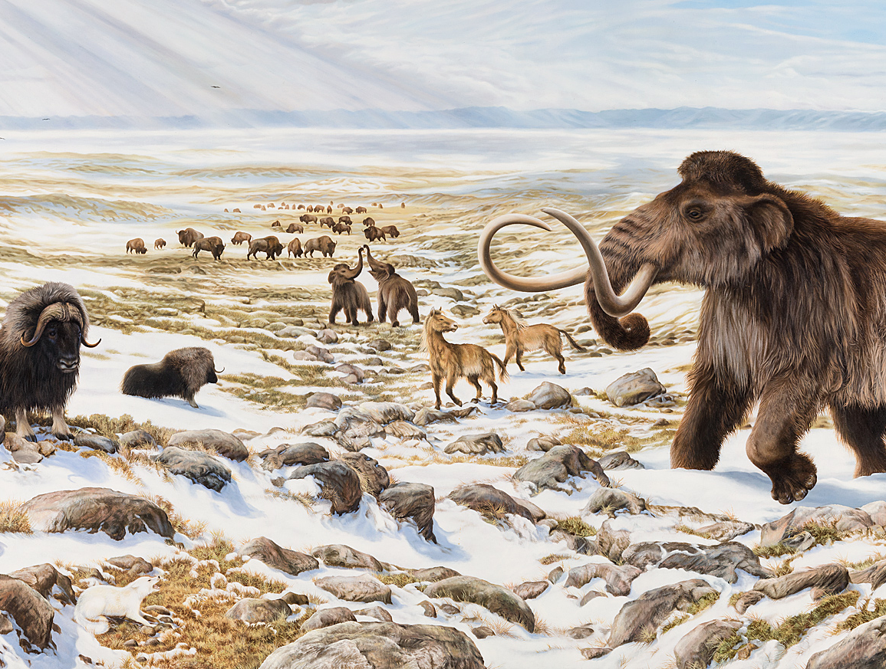
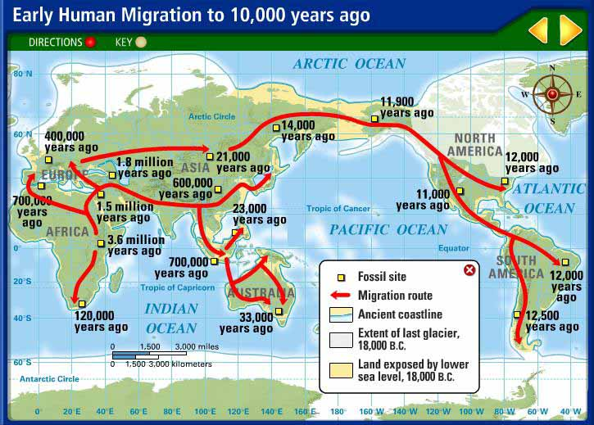
Notes:
Dene: Ya – MO – ya

Slide 5
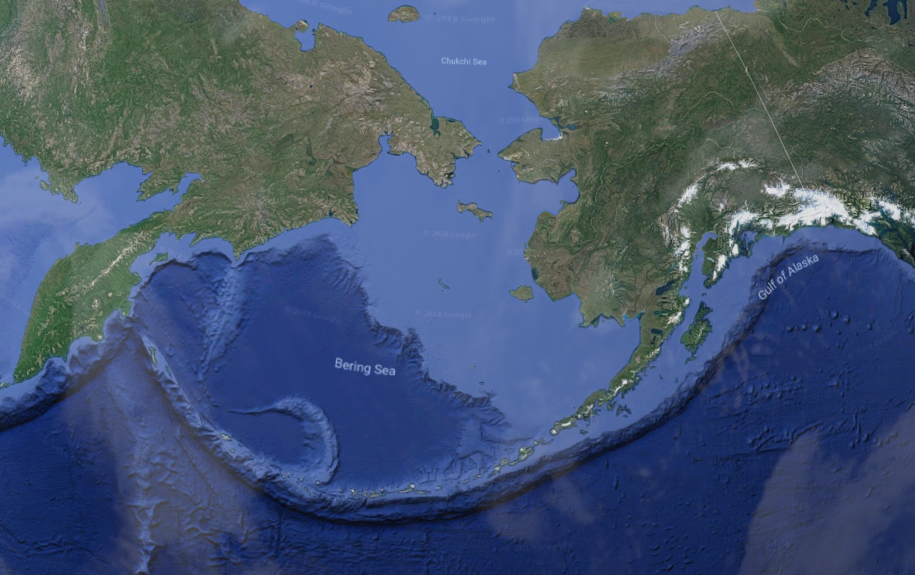
Notes:
Dene: Ya – MO – ya

Slide 6
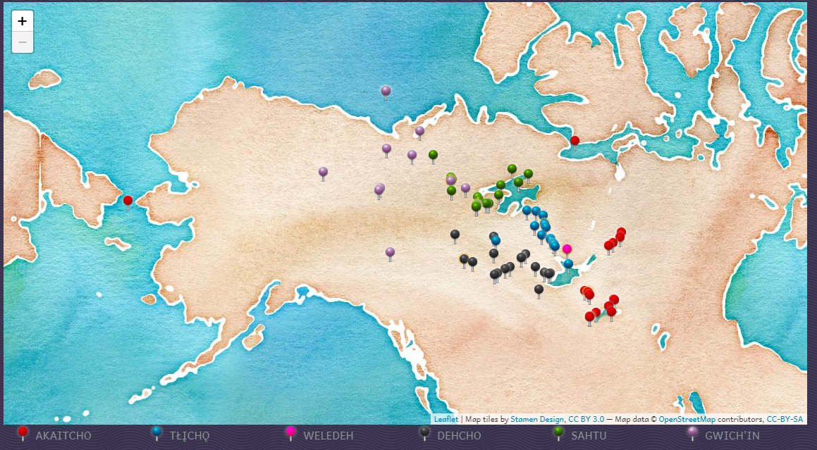

Slide 7
Notes:
http://www.beringia.com/exhibits/ice-age-animals

Slide 8
Wooly Mammoth
3m tall
Ate 200 kg of grass each day.
Notes:
http://www.beringia.com/exhibits/ice-age-animals

Slide 9
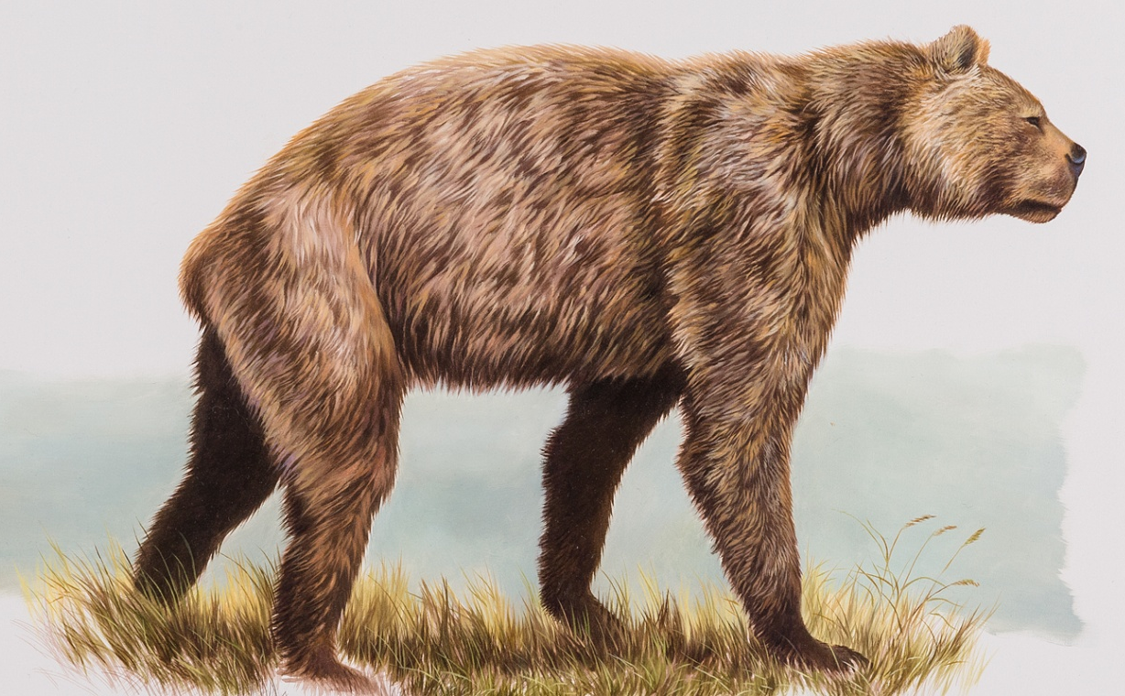
Giant Short-Faced Bear
North America’s Largest Mammalian Land Carnivore ever.
1.5 m tall, 4.3 m reach on hind legs
Notes:
http://www.beringia.com/exhibit/ice-age-animals/giant-short-faced-bear

Slide 10
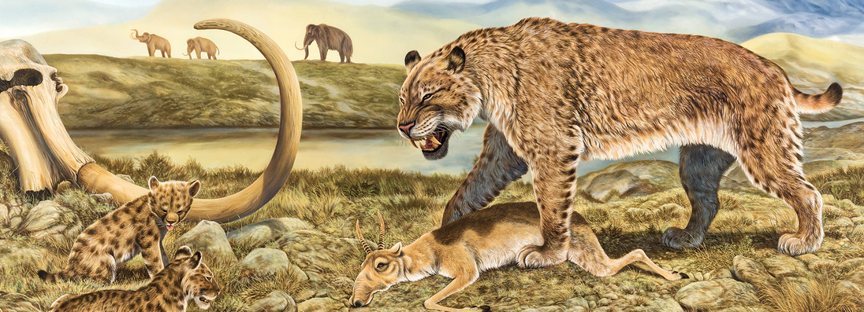
Scimitar Cat
200 kg
Cousin to the Sabre Tooth Cat
Didn’t like tummy rubs
Notes:
http://www.beringia.com/exhibit/ice-age-animals/american-scimitar-cat

Slide 11
Jefferson’s Ground Sloth
The size of an ox
Yeah.
Notes:
http://www.beringia.com/exhibits/ice-age-animals

Slide 12
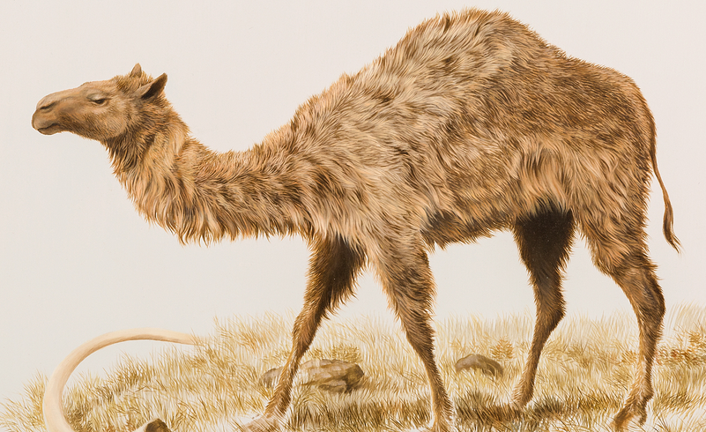
Yukon’s Camels
A freaking camel??
Notes:
http://www.beringia.com/exhibits/ice-age-animals

Slide 13
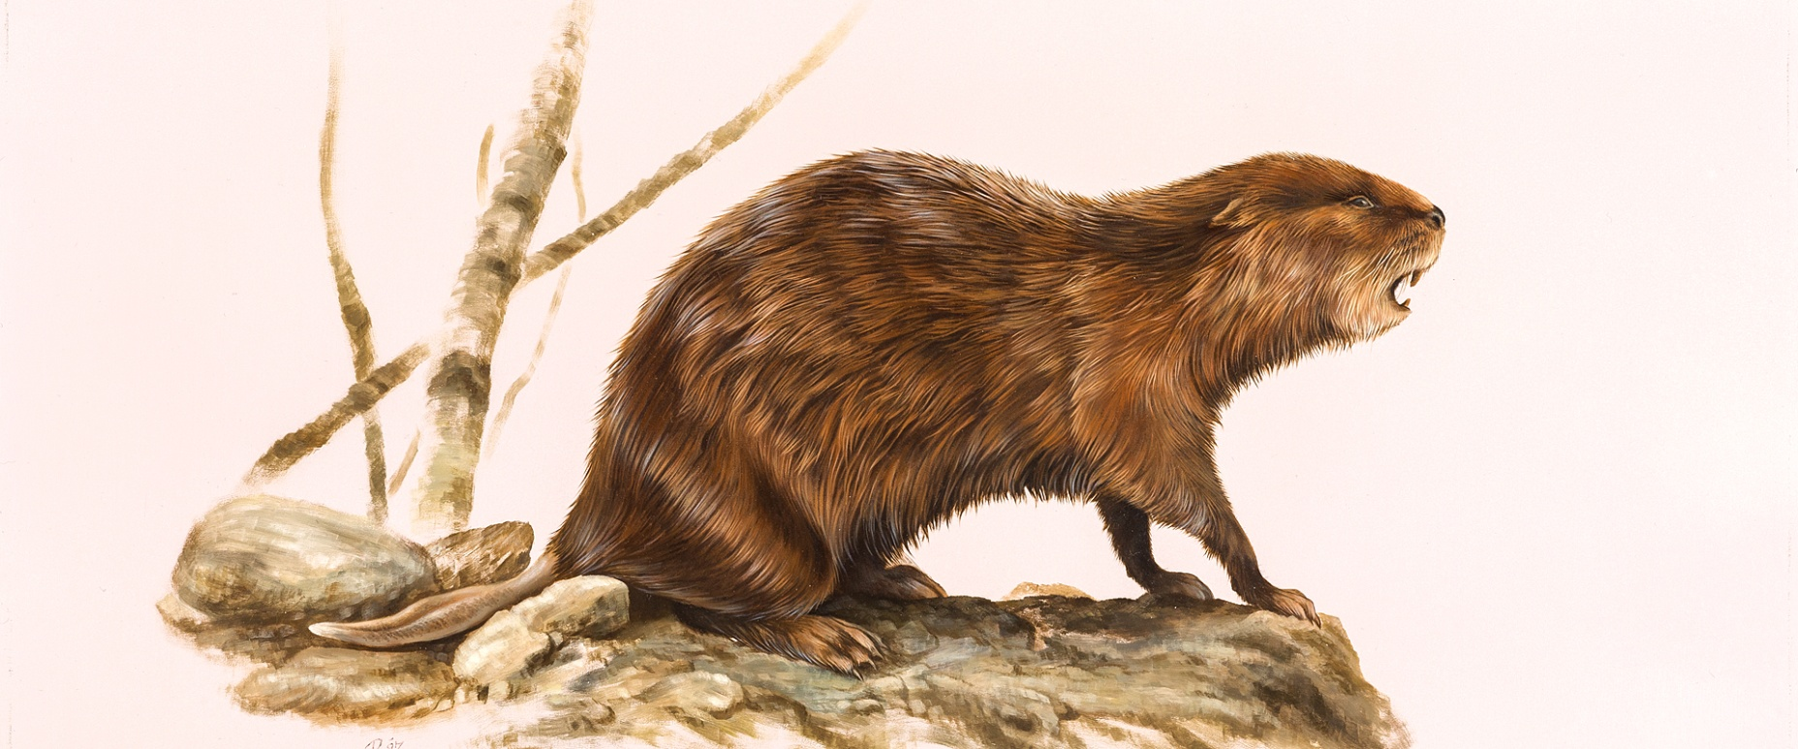
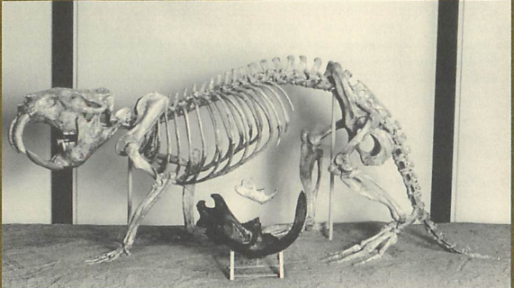
Giant Beaver
Largest rodent ever – 2.5m long, up to 200 kg
Likely herbivorous, aggressive?
Notes:
http://www.beringia.com/exhibits/ice-age-animals
VIDEO Giant Beaver Story. It’s a rodent the size of a wild boar…

Slide 15
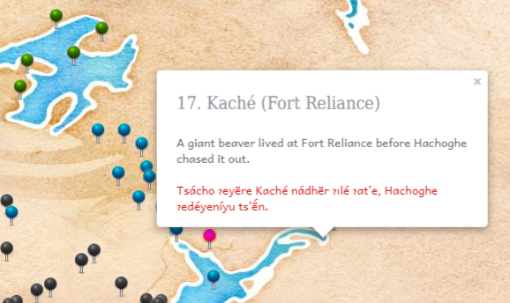
Notes:
Giant Beavers

Slide 16
Notes:
More Giant Beavers

Slide 17
Notes:
More Giant Beavers

Slide 18
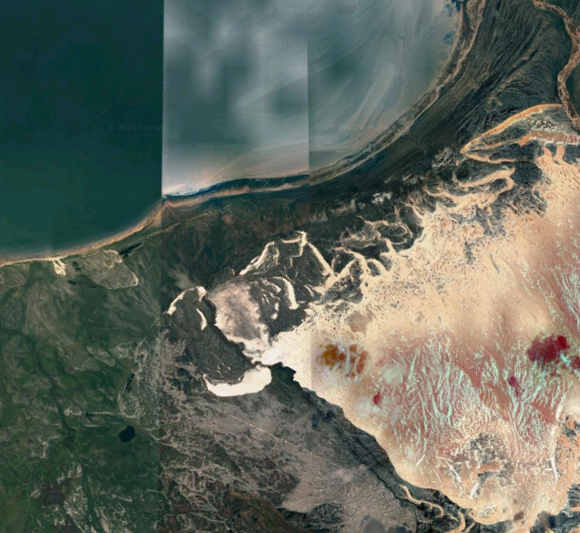
Notes:
More than a dozen references to giant beavers among the Dene stories on this map.

Slide 19
Giant Beaver
Aggressive.

Slide 20
www.nwtexhibits.ca/yamoria/
Very accessible for students!
The act of storytelling is a small but important application of foundational knowledge Tell FNMI stories!
Tell science history stories!
Tell your own stories!
Notes:
I have no authority at all to propose such, but I think that even the act of storytelling itself is a way to honour FNMI perspectives. Even if those stories are coming from European traditions.

