Slide 1
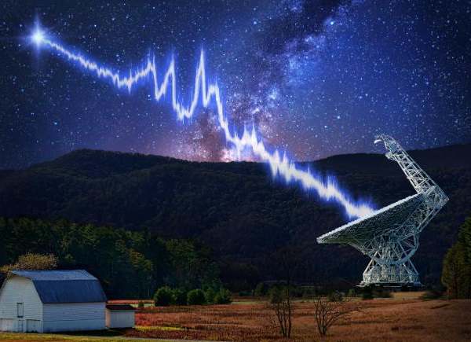
The Peryton Next Door
Physics 30 Unit C (EMR)
Science 30 Unit C (EMR)
Sometimes the discovery is underwhelming
Notes:
Perytons: https://arxiv.org/abs/1504.02165

Slide 2
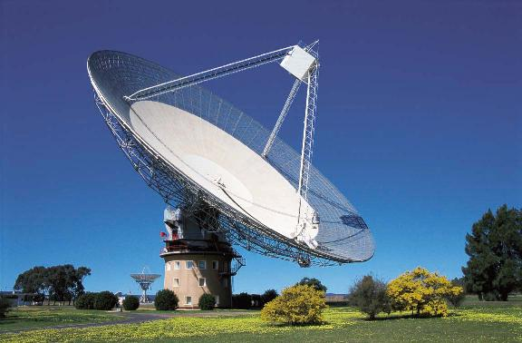
The Peryton Next Door
Physics 30 Unit C (EMR)
Science 30 Unit C (EMR)
Notes:
Fast Radio Bursts are high energy astrophysical phenomena of unknown origin that manifest as a transient radio pulse lasting only a few milliseconds. First discovered in 2007, many have now been found, including a repeating FRB. When FRBs are polarized, it indicates that they are emitted from a source contained within an extremely powerful magnetic field. The origin of FRBs has yet to be determined; proposals ranging from rapidly rotating neutron stars, a black hole, or extraterrestrial intelligence.
In 2010 there was a report of 16 similar pulses, detected by the Parkes radio telescope.

Slide 3
1.4 GHz, w/ 2.3-2.5 GHz
The Peryton Next Door
Physics 30 Unit C (EMR)
Science 30 Unit C (EMR)
Notes:
In 2010 there was a report of 16 similar pulses, detected by the Parkes radio telescope. They were noticed at a frequency range of 1.4 GHz, associated with other emissions between 2.3-2.5 GHz.

Slide 4
1.4 GHz, w/ 2.3-2.5 GHz
The Peryton Next Door
Physics 30 Unit C (EMR)
Science 30 Unit C (EMR)
Notes:
Giga = 10^9, what comes in the GHz range on this scale?

Slide 5
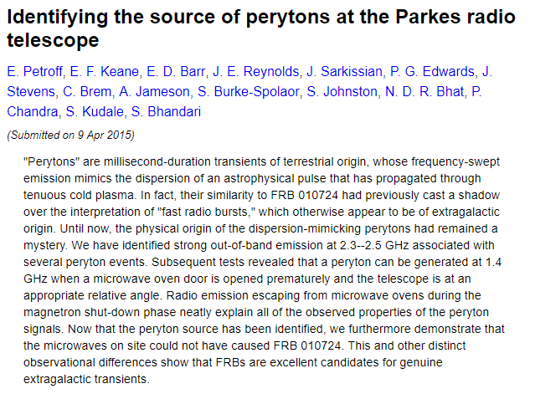
1.4 GHz, w/ 2.3-2.5 GHz
The Peryton Next Door
Physics 30 Unit C (EMR)
Science 30 Unit C (EMR)
Notes:
Giga = 10^9, what comes in the GHz range on this scale?

Slide 6
1.4 GHz, w/ 2.3-2.5 GHz
The Peryton Next Door
Physics 30 Unit C (EMR)
Science 30 Unit C (EMR)
Notes:
Yep, opening the microwave too soon – as the magnetron shuts down the little bit of GHz frequency radiation escapes and was detected by the telescope

Slide 7
1.4 GHz, w/ 2.3-2.5 GHz
Peryton Next Door
Sometimes the answers to exciting questions have mundane answers.
Mundane answers are important
The Peryton Next Door
Physics 30 Unit C (EMR)
Science 30 Unit C (EMR)
Notes:
Yep, opening the microwave too soon – as the magnetron shuts down the little bit of GHz frequency radiation escapes and was detected by the telescope

